Slide 1

Algebra 1
Unit 13, Lesson 11 Calculating and Interpreting Average Rate of Change Volume 2, pg. 291

Slide 2


Benchmark
MA.912.F.1.3
Calculate and interpret the average rate of change of a real-world situation represented graphically, algebraically, or in a table over a specified interval.
volume 2, pg. 291

Slide 3
Integrated Mathematical Thinking and Reasoning Standards
MA.K12.MTR.1.1 Actively participate in effortful learning both individually and collectively.
MA.K12.MTR.2.1 Demonstrate understanding by representing problems in multiple ways.
MA.K12.MTR.3.1 Complete tasks with mathematical fluency.
MA.K12.MTR.4.1 Engage in discussions that reflect on the mathematical thinking of self and others.
MA.K12.MTR.6.1 Assess the reasonableness of solutions.
MA.K12.MTR.7.1 Apply mathematics to real-world contexts.
volume 2, pg. 291

Slide 4

Learning Targets
I can calculate the average rate of change of a real-world situation represented graphically, algebraically, or in a table over a specified interval.
I can interpret the average rate of change in a real-world context.
volume 2, pg. 291

Slide 5

Warm-Up
volume 2, pg. 291

Slide 6
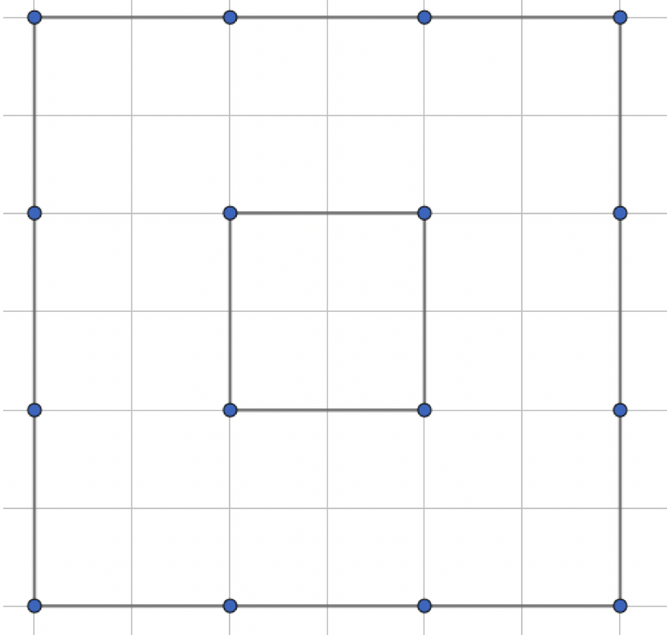

13.11.1 Warm-Up: Critical Thinking
Two squares are shown on the grid that were created using line segments.
Move $4$ line segments to create $3$ squares.
volume 2, pg. 291

Slide 7

Guided Instruction
volume 2, pg. 292

Slide 8

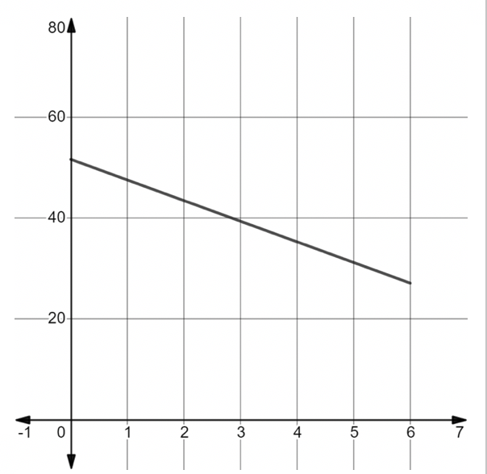
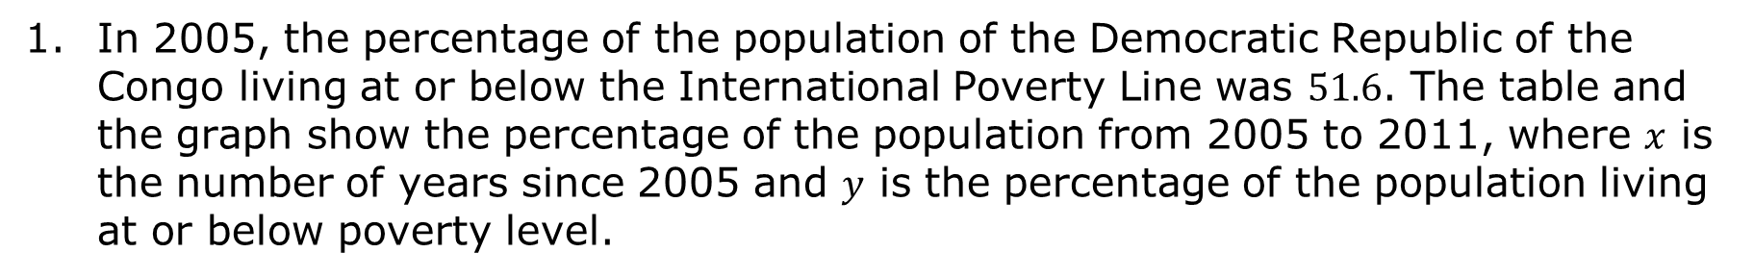
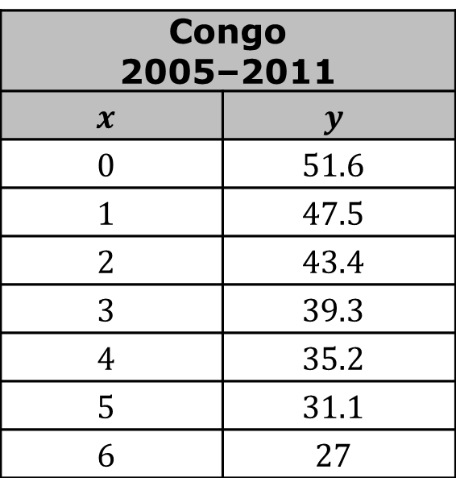
13.11.2 Guided Instruction: Average Rate of Change
In 2005, the percentage of the population of the Democratic Republic of the Congo living at or below the International Poverty Line was $51.6$. The table and the graph show the percentage of the population from 2005 to 2011, where $x$ is the number of years since 2005 and $y$ is the percentage of the population living at or below poverty level.
Congo 2005–2011
$$x$$ | $$y$$
$$0$$ | $$51.6$$
$$1$$ | $$47.5$$
$$2$$ | $$43.4$$
$$3$$ | $$39.3$$
$$4$$ | $$35.2$$
$$5$$ | $$31.1$$
$$6$$ | $$27$$
volume 2, pg. 292

Slide 9
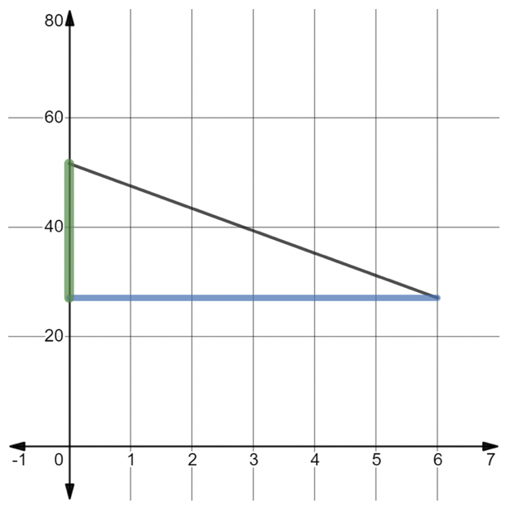
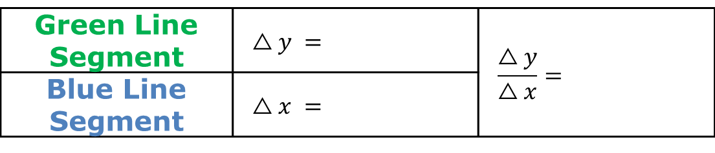
Using the graph of the relationship, discuss with your partner how the triangle formed shows the slope.
Complete the table to find the slope.
Green Line Segment | $$△y =$$ | $$\frac{△y}{△x}=$$
Blue Line Segment | $$△x =$$
volume 2, pg. 292

Slide 10
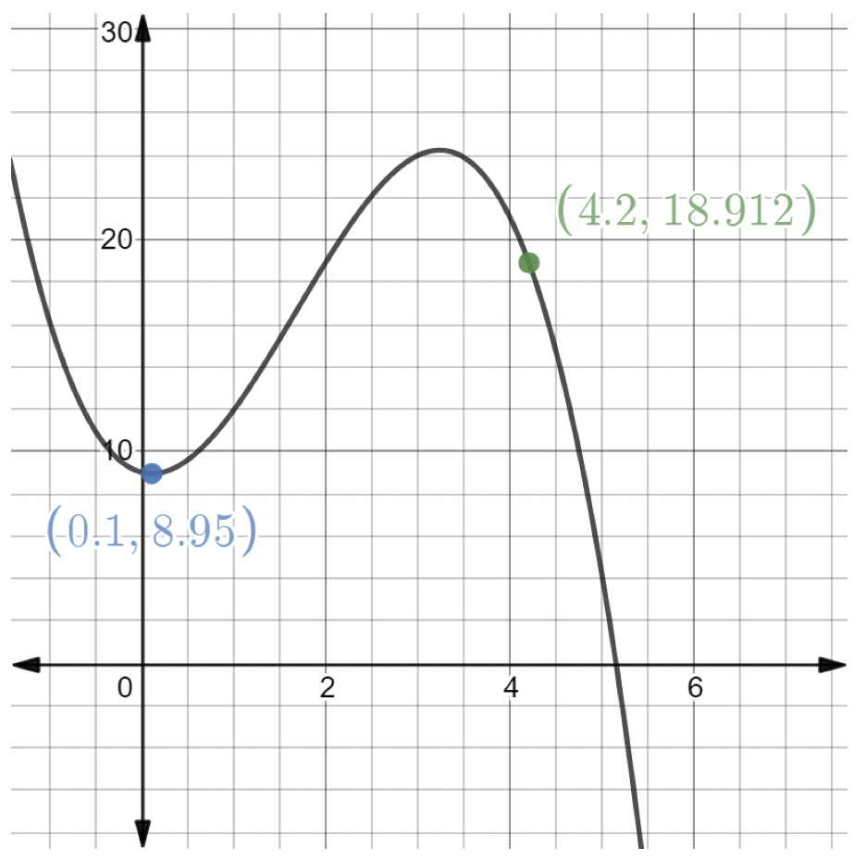
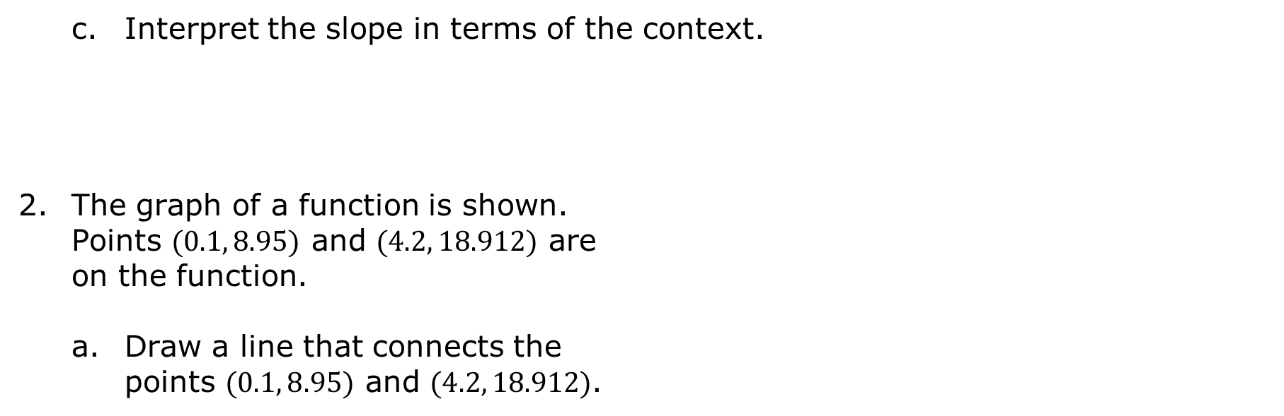
Interpret the slope in terms of the context.
The graph of a function is shown. Points $(0.1, 8.95)$ and $(4.2, 18.912)$ are on the function.
Draw a line that connects the points $(0.1, 8.95)$ and $(4.2, 18.912)$.
volume 2, pg. 292

Slide 11
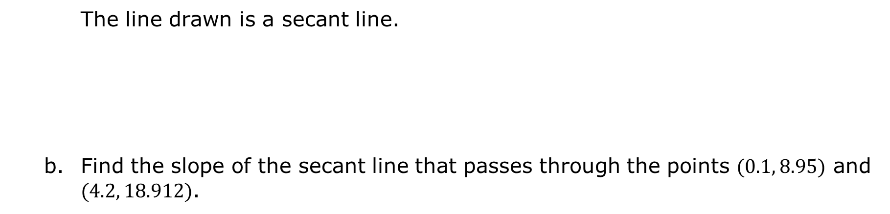
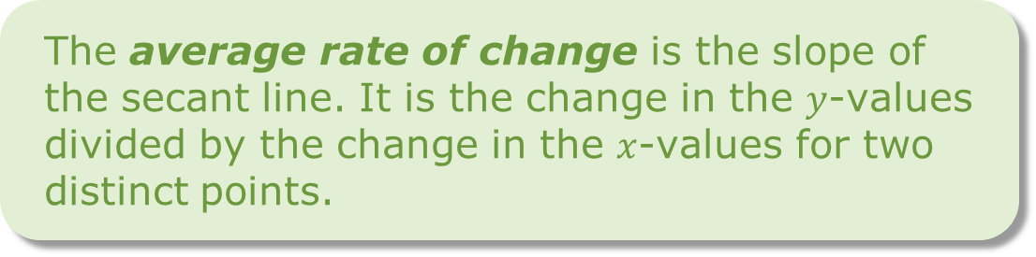
The line drawn is a secant line.
Find the slope of the secant line that passes through the points $(0.1, 8.95)$ and $(4.2, 18.912)$.
A secant line is a line that passes through two points of a curve.
The average rate of change is the slope of the secant line. It is the change in the $y$-values divided by the change in the $x$-values for two distinct points.
volume 2, pg. 292

Slide 12
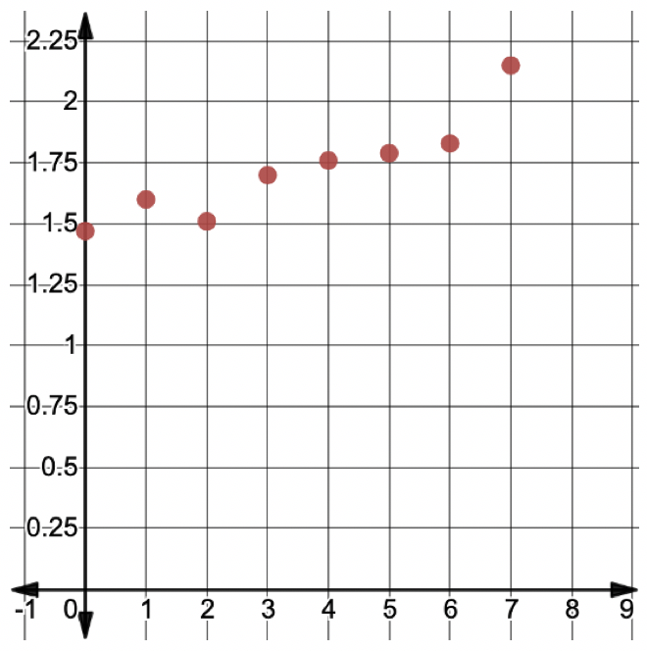
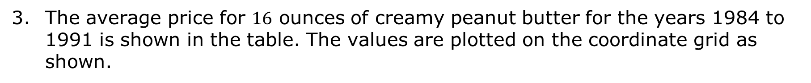
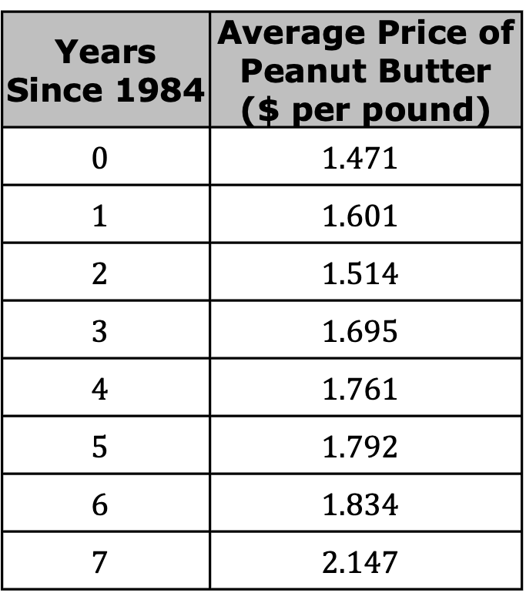
The average price for $16$ ounces of creamy peanut butter for the years 1984 to 1991 is shown in the table. The values are plotted on the coordinate grid as shown.
Years Since 1984 | Average Price of Peanut Butter ($ per pound)
$$0$$ | $$1.471$$
$$1$$ | $$1.601$$
$$2$$ | $$1.514$$
$$3$$ | $$1.695$$
$$4$$ | $$1.761$$
$$5$$ | $$1.792$$
$$6$$ | $$1.834$$
$$7$$ | $$2.147$$
volume 2, pg. 293

Slide 13
Find the average rate of change for the interval 1985 to 1989. Include units.
Find the average rate of change for the interval 1984 to 1991.
volume 2, pg. 293

Slide 14
Interpret the average rate of change for the interval 1984 to 1991 in terms of the context.
What do you notice about the average rates of change for 1985 to 1989 and 1984 to 1991?
volume 2, pg. 294

Slide 15
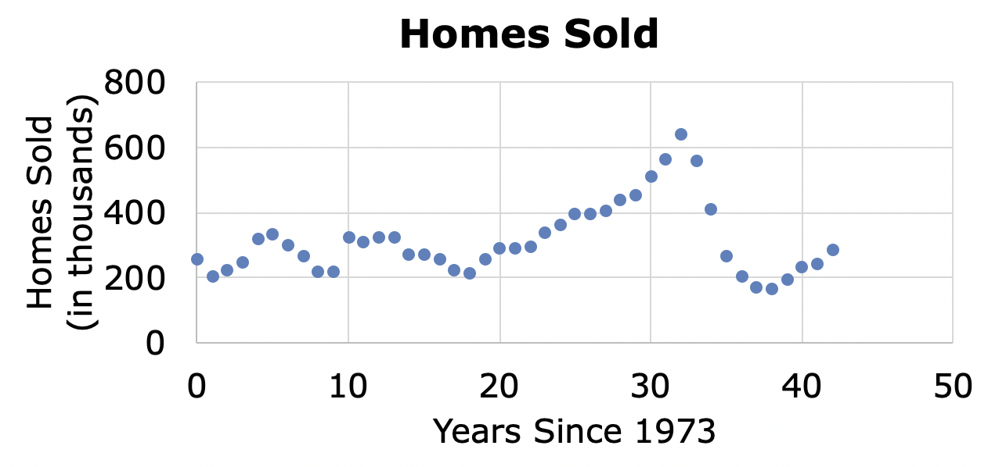
Mathematicians and economists often want to evaluate changes that have occurred over different time intervals to analyze trends and make predictions.
The graph shows the number of homes sold in the U.S., in thousands, from 1973 to 2015.
volume 2, pg. 294

Slide 16
Draw a line from the first data point to the last data point.
Discuss with your partner why finding a rate of change using the first data point to the last data point would not give much information about how the number of sales has changed.
volume 2, pg. 294

Slide 17
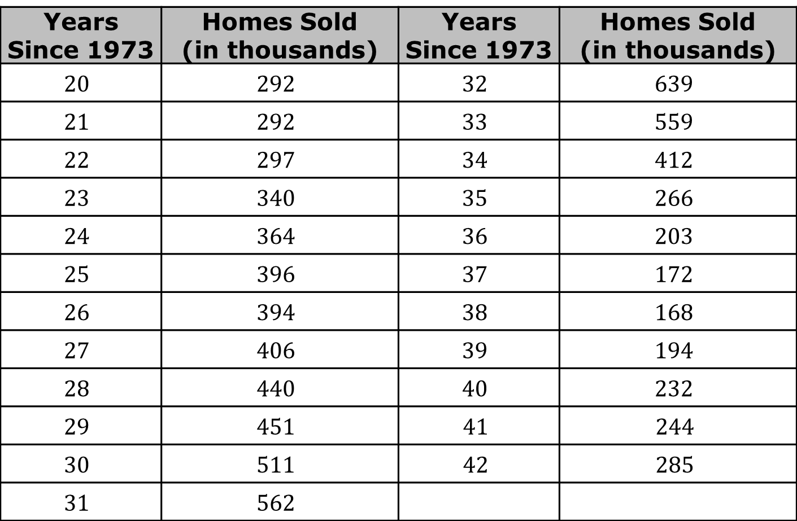
The table shows some of the values from the graph.
Years Since 1973 | Homes Sold (in thousands) | Years Since 1973 | Homes Sold (in thousands)
$$20$$ | $$292$$ | $$32$$ | $$639$$
$$21$$ | $$292$$ | $$33$$ | $$559$$
$$22$$ | $$297$$ | $$34$$ | $$412$$
$$23$$ | $$340$$ | $$35$$ | $$266$$
$$24$$ | $$364$$ | $$36$$ | $$203$$
$$25$$ | $$396$$ | $$37$$ | $$172$$
$$26$$ | $$394$$ | $$38$$ | $$168$$
$$27$$ | $$406$$ | $$39$$ | $$194$$
$$28$$ | $$440$$ | $$40$$ | $$232$$
$$29$$ | $$451$$ | $$41$$ | $$244$$
$$30$$ | $$511$$ | $$42$$ | $$285$$
$$31$$ | $$562$$
volume 2, pg. 295

Slide 18
Find the average rate of change for the time period of 1993 to 2005.
Interpret the average rate of change for the interval 1993 to 2005 in terms of the context.
volume 2, pg. 295

Slide 19
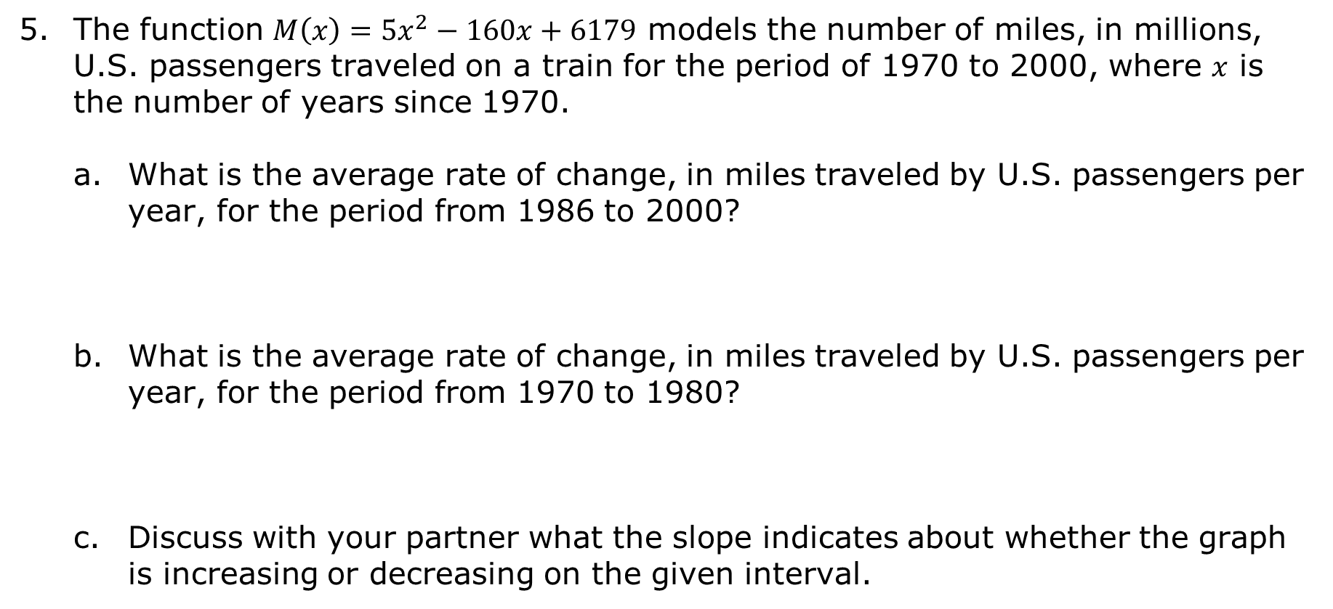
The function $M\left(x\right)=5x^{2}−160x+6179$ models the number of miles, in millions, U.S. passengers traveled on a train for the period of 1970 to 2000, where $x$ is the number of years since 1970.
What is the average rate of change, in miles traveled by U.S. passengers per year, for the period from 1986 to 2000?
What is the average rate of change, in miles traveled by U.S. passengers per year, for the period from 1970 to 1980?
Discuss with your partner what the slope indicates about whether the graph is increasing or decreasing on the given interval.
volume 2, pg. 295

Slide 20

Try It
volume 2, pg. 296

Slide 21

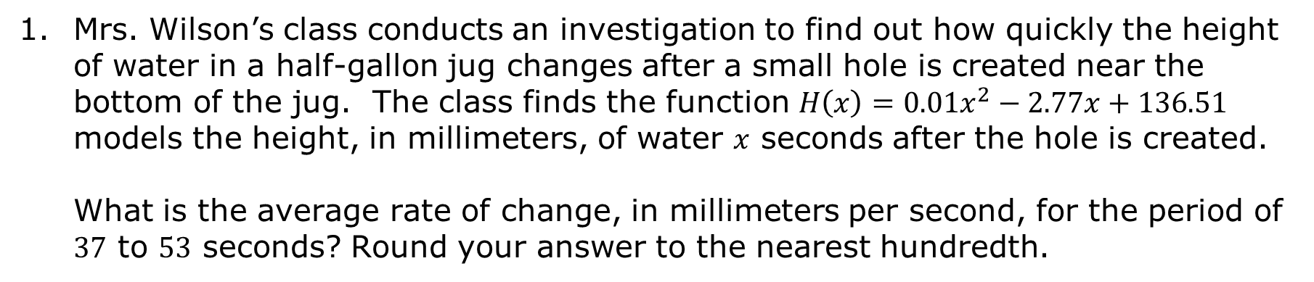
13.11.3 Try It: Average Rate of Change
Mrs. Wilson’s class conducts an investigation to find out how quickly the height of water in a half-gallon jug changes after a small hole is created near the bottom of the jug. The class finds the function $H\left(x\right)=0.01x^{2}−2.77x+136.51$ models the height, in millimeters, of water $x$ seconds after the hole is created.
What is the average rate of change, in millimeters per second, for the period of $37$ to $53$ seconds? Round your answer to the nearest hundredth.
volume 2, pg. 296

Slide 22
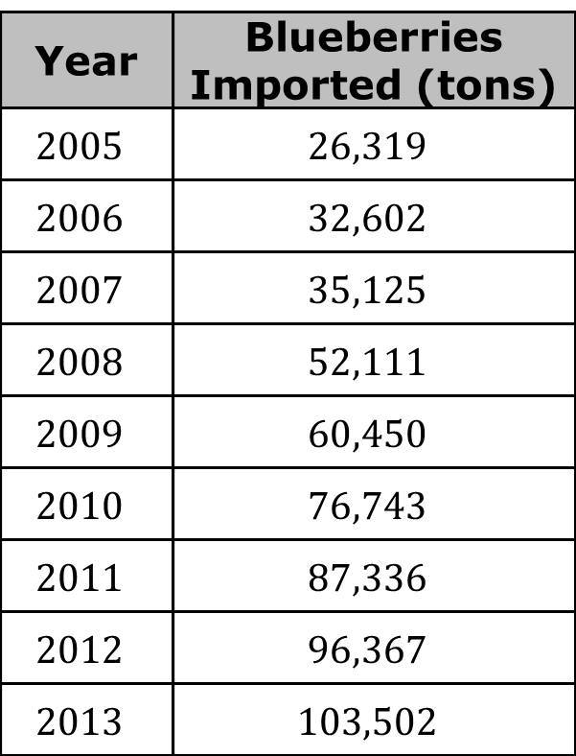
The table shows the number of tons of blueberries that were imported to the US from 2005 to 2013.
Determine the average rate of change from 2007 to 2012.
Interpret the average rate of change for the interval 2007 to 2012 in terms of the context.
Year | Blueberries Imported (tons)
$$2005$$ | $$26,319$$
$$2006$$ | $$32,602$$
$$2007$$ | $$35,125$$
$$2008$$ | $$52,111$$
$$2009$$ | $$60,450$$
$$2010$$ | $$76,743$$
$$2011$$ | $$87,336$$
$$2012$$ | $$96,367$$
$$2013$$ | $$103,502$$
volume 2, pg. 296

Slide 23

Wrap-Up
volume 2, pg. 297

Slide 24
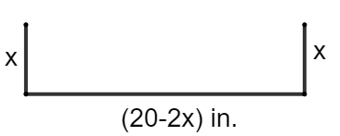

13.11.4 Wrap-Up: Ticket Out the Door
A rain gutter is made from a $20$ inch (in.) aluminum sheet with the edges folded up, as shown.
Flat Aluminum Sheet | Sheet Folded for Rain Gutter
volume 2, pg. 297

Slide 25
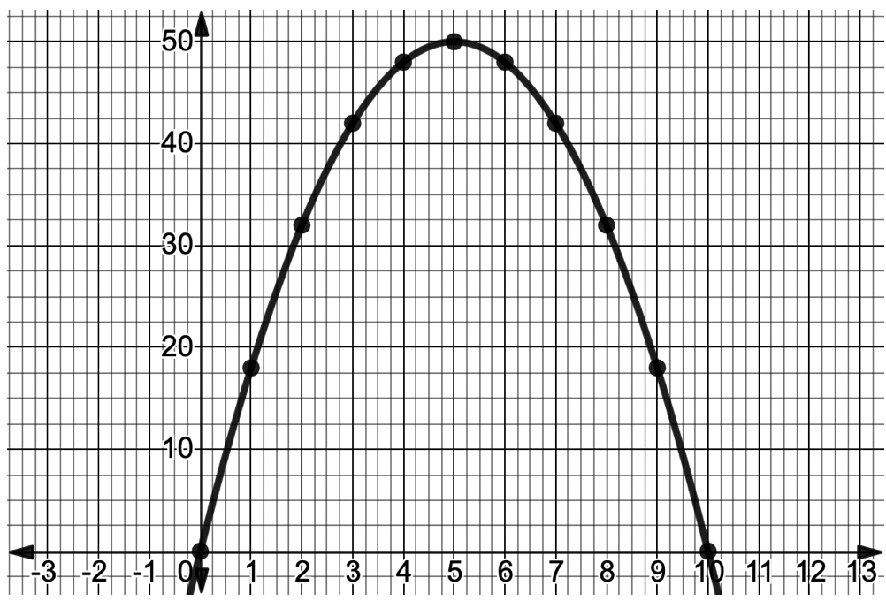
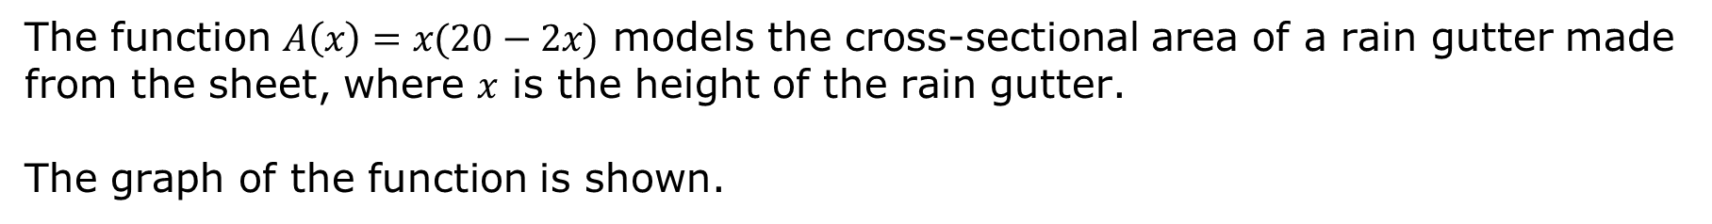
The function $A\left(x\right)=x(20−2x)$ models the cross-sectional area of a rain gutter made from the sheet, where $x$ is the height of the rain gutter.
The graph of the function is shown.
volume 2, pg. 297

Slide 26
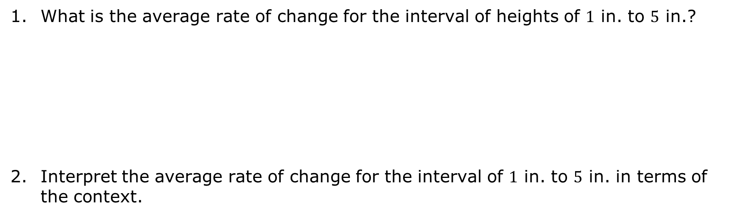
What is the average rate of change for the interval of heights of $1$ in. to $5$ in.?
Interpret the average rate of change for the interval of $1$ in. to $5$ in. in terms of the context.
volume 2, pg. 297

